Slide 1

Python for Data Science
19CSE432: Lecture 25
B. Tech. 2021
Course Leader:
Dr. Yatish Bathla
yatishbathla.cs.et@msruas.ac.in
yatishbathla@outlook.com
Dr. Mohan Kumar
mohan.cs.et@msruas.ac.in

Slide 2
Lecture Objectives
At the end of this lecture, student will be able to understand
Python Unit Testing module
Test Driven Development (TDD)
Acceptance Testing of python software
Behaviour Driven Development (BDD)
Virtual environments for testing
Debugging and Python debugger

Slide 3
Topics
Python Unit Testing module: Automated vs. Manual Testing, Unit Tests vs. Integration Tests, Choosing Test Runners, unittest module, Unit Test Structure
Test Driven Development: Introduction, Ethos of TDD, Advantage
Acceptance Testing of python software: Introduction, Acceptance Criteria, Acceptance Testing in SDLC, Anatomy of an Acceptance Test , Goals of Acceptance Testing
Behavior Driven Development: Introduction, Cucumber Framework(Using Gherkin Syntax), Robot Framework
Virtual environments for testing: Introduction, Virtualenvwrapper
Debugging and Python debugger: Introduction, PDB- Interactive Debugger

Slide 4
Python Unit Testing module
Automated vs Manual Testing
Manual (Exploratory) testing: It is a form of testing that is done without a plan. To have a complete set of manual tests, all you need to do is make a list of all the features your application has, the different types of input it can accept, and the expected results. Now, every time you make a change to your code, you need to go through every single item on that list and check it.
Automated testing: It is the execution of your test plan (the parts of your application you want to test, the order in which you want to test them, and the expected responses) by a script instead of a human. Python already comes with a set of tools and libraries to help you create automated tests for your application

Slide 5
Python Unit Testing module
Unit Tests vs. Integration Tests
Integration testing: Think of how you might test the lights on a car. You would turn on the lights (known as the test step) and go outside the car or ask a friend to check that the lights are on (known as the test assertion). Testing multiple components is known as integration testing. It checks that components in your application operate with each other.
Unit testing: A unit test is a smaller test, one that checks that a single component operates in the right way. A unit test helps you to isolate what is broken in your application and fix it faster.

Slide 6
Python Unit Testing module
Choosing a Test Runner
The three most popular test runners are:
Unittest: It has been built into the Python standard library since version 2.1. It contains both a testing framework and a test runner. unittest has some important requirements for writing and executing tests
Nose or Nose2: It extends unittest to make testing easier. It’s is a fairly well known python unit test framework, and can run doctests, unittests, and “no boilerplate” tests
Pytest: It supports execution of unittest test cases. The real advantage of pytest comes by writing pytest test cases. pytest test cases are a series of functions in a Python file starting with the name test_

Slide 7
Python Unit Testing module
Unit Test Structure
When structuring your project, you can follow some clear standards to make your application’s code more accessible. These simple rules are easy to apply and result in a uniform structure to make it easy to find the test and code files you need.
■ Unit tests should be placed under a test/unit directory at the top level of your project folder.
■ All folders within the application’s code should be mirrored by test folders under test/unit, which will have the unit tests for each file in them. For example, app/ data should have a mirrored folder of test/unit/app/data.
■ All unit test files should mirror the name of the file they are testing, with _test as the
suffix. For example, app/data/data_interface.py should have a test file of test/unit/app/data/data_interface_test.py.

Slide 8
Python Unit Testing module
unittest Module supports some important concepts in an object-oriented way:
test fixture: It represents the preparation needed to perform one or more tests, and any associated cleanup actions. This may involve, for example, creating temporary or proxy databases, directories, or starting a server process.
test case: It is the individual unit of testing. It checks for a specific response to a particular set of inputs. unittest provides a base class, TestCase, which may be used to create new test cases.
test suite: It is a collection of test cases, test suites, or both. It is used to aggregate tests that should be executed together.
test runner: It is a component which orchestrates the execution of tests and provides the outcome to the user. The runner may use a graphical interface, a textual interface, or return a special value to indicate the results of executing the tests.

Slide 9
Time Driven Development (TDD)
Introduction
A style of development that enables you to focus on testing your application and ensuring it delivers the features and functionality that you set out to create.
TDD gives you great confidence that each new piece of functionality you write in your code is backed by a test, which confirms how it behaves.
Test driven development is often a key part of the agile development process, which advocates iterative development over more restrictive processes such as waterfall.
The process is effectively centered on a few key pillar concepts. The average iteration in an agile team is known as a “sprint.”

Slide 10
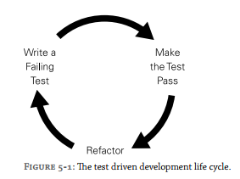
Time Driven Development (TDD)
Ethos
The basic concept of TDD is to write a failing test first, before writing any code.
Then your test would fail indicating that the method and class do not exist, and you can begin developing them.
The tests guide your development, making you think about their exact behavior and responsibilities before you actually write any code.

Slide 11
Time Driven Development (TDD)
Advantage
As the application evolves, so does the testing suite cover all the functionality of your application.
Excellent opportunities emerge to engage developers when pair programming, undertaking development practices such as “ping-pong programming,”
Testing tools, such as coverage, ensure that you are testing every part of your application and not leaving any holes in your test suite and keep you on your toes.
You can have confidence in the code that you have produced because your tests have proved the code behaves in the way the developer expects it to, before going live to production.
Fail Fast! A full test suite allows you to develop and pick up bugs as they are created, rather than having to find out later in integration testing or worse, production environments in real user scenarios.
You avoid gold plating. TDD keeps you from adding features and functionality outside of what is required. The cost of a feature is reflected in the effort required to write the tests.

Slide 12
Acceptance Testing
Introduction
A testing technique performed to determine whether the software system has met the requirement specifications. The main purpose of this test is to evaluate the system's compliance with the business requirements and verify if it is has met the required criteria for delivery to end users.
There are various forms of acceptance testing:
User acceptance Testing
Business acceptance Testing
Alpha Testing
Beta Testing.

Slide 13
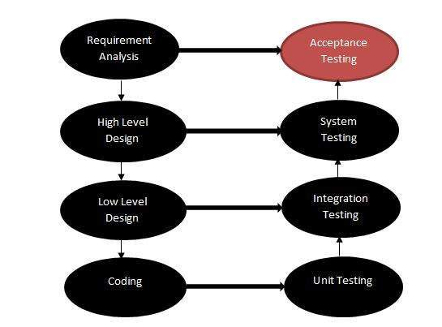
Acceptance Testing
SDLC (Software Development LifeCycle)

Slide 14
Acceptance Testing
Anatomy
Acceptance tests have been described as having a “feature” file describing the test and step files that actually execute the code to perform the test. To give you a sense of exactly how the tests will work and be created, this section details exactly what these files are composed of.
One of the most important things to note when writing acceptance tests is that they follow a very familiar style and pattern, regardless of the language they are being implemented in

Slide 15
Acceptance Testing
Goal
There is a key distinction between unit tests and acceptance tests. You could consider your unit tests the fundamental foundations on which your application is built. They ensure that the individual elements of your application work as you intend them to, in isolation.
Acceptance tests then take these foundations and ensure they work together to support the whole. When you chain your classes and methods together to create a fully functioning application, acceptance tests check that the behavior of your application is as expected. They can also go a step further than just checking responses and their contents.
Acceptance tests are classically used for testing web applications, clicking around elements of a website as a user would and asserting that the correct items are shown onscreen.

Slide 16
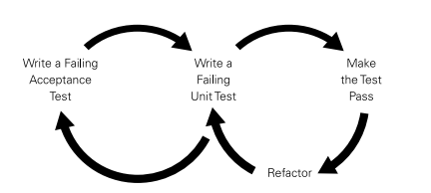
Behavior Driven Development
Introduction
Much in the same way as unit tests allow us to follow the Test Driven Development (TDD) approach, acceptance tests allow the behavior driven development (BDD) approach
Behavior driven development—the process of writing these acceptance tests before writing any code—clearly combines with the TDD approach
As you write the tests to cover the features you are delivering, you are effectively writing testable documentation for your application.

Slide 17
Behavior Driven Development
Cucumber Framework
One of the most famous implementations of acceptance testing comes in the form of “Cucumber” tests, a library written for the Ruby programming language.
It is defined the style of writing the business definition of a “feature” in your own language and being able to execute that feature as a way of testing your application
The implementation for Python is known as “Lettuce,” and the framework will be used here to illustrate the anatomy of acceptance tests.
Using Gherkin Syntax: Feature, Scenario, Scenario Outline, Given, When, Then, And

Slide 18
Behavior Driven Development
Robot Framework
The package has great support in continuous integration tool Jenkins, for example, with plug-ins providing test results output, tracking the amount of tests, and highlighting failing tests.
Robot tests follow some of the structure philosophies that Lettuce demonstrates, such as having a readable feature file and step definitions that execute the code to perform the test.
Robot makes use of spacing and a tabular format to parse the feature file; in that respect, Robot is stricter in its style for producing these kinds of tests
Robot makes use of Python “under the hood,” you can use WebTest to drive some of the interaction with the application and make sending requests and parsing responses easy.

Slide 19
Virtual environments for testing
Introduction
A virtual environment is a private copy of the Python interpreter, onto which you can install packages privately, without affecting the global Python interpreter installed in your system.
The more projects you have, the more likely it is that you will be working with different versions of Python itself, or at least different versions of Python libraries. For this reason, we use virtual environments
Virtualenvwrapper: It provides a set of commands and places all your virtual environments in one place

Slide 20
Debugging and Python debugger
Introduction
pdb implements an interactive debugging environment for Python programs.
It includes features to let you pause your program, look at the values of variables, and watch program execution step-by-step, so you can understand what your program actually does and find bugs in the logic
The first step to using pdb is causing the interpreter to enter the debugger when you want it to. There are a few different ways to do that, depending on your starting conditions and what you need to debug
For a long-running process where the problem appears much later in the program execution, it will be more convenient to start the debugger from inside your program using set_trace().

Slide 21
Summary
We have learned about Python Unit Testing module where different testing methodology, different types of Test Runners focussed on the unittest module and Unit Test Structure are explained
Then Test-Driven Development is explained where its Advantages are discussed.
Then Acceptance Testing is explained where Behavior Driven Development is foccussed.
Finally, Virtual environment and Python debugger are discussed.

